Slide 1
Museums, Libraries, and 21st Century Skills

Slide 2
What will learning look
like in the future?
Notes:
The “Four Questions” exercise has been adapted from 21st Century Skills: Learning for Life in Our Times, by Bernie Trilling and Charles Fadel. It is a fun and interactive way to jump-start the conversation on 21st century skills with any audience regardless of participants’ prior knowledge.
The exercise is designed to make the topic of learning today and tomorrow real and personal. As you ask the questions, invite people to call out their responses. Depending on your time constraints, you can make this a purely verbal exchange, with the facilitator repeating and embellishing the responses, or you might ask someone to record the responses on a newsprint pad.
There are no “right” and “wrong” answers. Questions One and Two refer to the broader environment and context for learning that our young people will encounter and the skills that will be required to navigate this environment successfully. Question Three asks individuals to reflect on their personal memorable and effective learning experiences. The final question draws on the responses to the first three, and usually elicits a pretty accurate description of 21st century skills and the needs of today’s learners.

Slide 3
Question #1
What will the world be like twenty or so years from now when the children who visit your institution have left school and are out in the world?
Notes:
Questions One and Two refer to the broader environment and context for learning that our young people will encounter and the skills that will be required to navigate this environment successfully.

Slide 4
Question #2
What skills will these children need to be successful in this world you have imagined twenty years from now?
Notes:
Questions One and Two refer to the broader environment and context for learning that our young people will encounter and the skills that will be required to navigate this environment successfully.

Slide 5
Question #3
What were the conditions that made your high-performance learning experiences so powerful?
Notes:
Question Three asks individuals to reflect on their personal memorable and effective learning experiences.

Slide 6
Question #4
What would learning be like if it were designed around your answers to the first three questions?
Notes:
Question four draws on the responses to the first three, and usually elicits a pretty accurate description of 21st century skills and the needs of today’s learners.

Slide 7
“For us to grow, we have to educate people to do jobs that don’t yet exist, which means we have to invent them and train people to do them at the same time. That is harder, and it is why we need everyone to aspire to be a creative creator or creative server.”
Thomas Friedman and Michael Mandelbaum, That Used to Be Us, pp. 137 (2011)
Notes:
The following three slides are quotes from various sources that describe well our new learning ecosystem and why 21st century skills become critical in these new environments.

Slide 8
What are 21st Century Skills?
Notes:
One well-vetted and widely accepted framework that defines “21st century skills” has been offered by the Partnership for 21st Century Skills (P21), a non-profit coalition sponsored by education, business, and community organization (www.p21.org)
The IMLS 21st century skills project team and a national task force of museum and library leaders used the P21 framework as the basis on which to customize this list of skills that are most relevant for libraries and museums for the 2009 IMLS report.
The framework is broken down into 4 main skill sets (Learning and Innovation Skills, Information, Media & Technology Skills, 21st century themes, and Life and Career Skills). Each of these four main skill sets is further broken down by skills that fall under that particular skill, as the following 4 slides show.

Slide 9
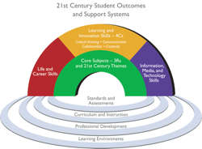
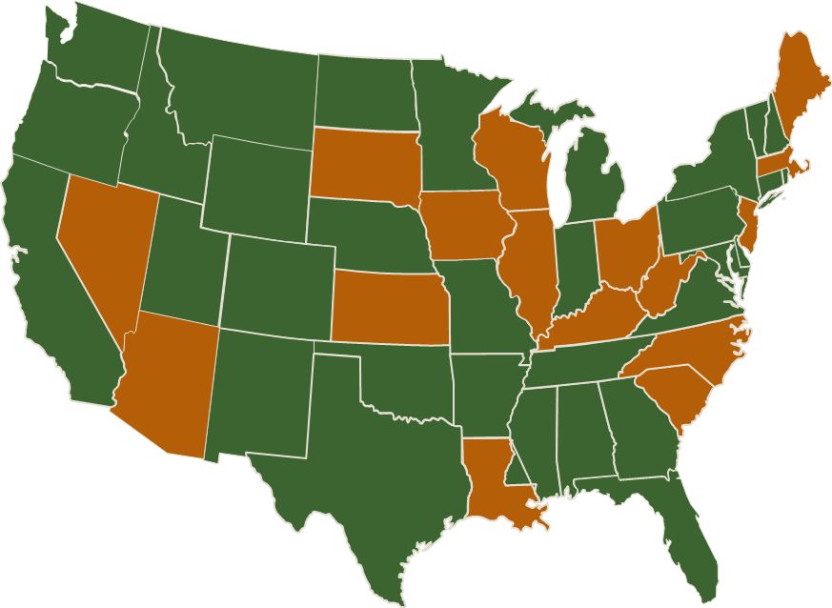
The Partnership for 21st Century Skills
Notes:
From the P21 Website (www.P21.org):
The Partnership for 21st Century Skills was formed in 2002 through the efforts of the following entities and individuals:
Government:
U.S. Department of Education
Founding Organizations:
AOL Time Warner Foundation
Apple Computer, Inc.
Cable in the Classroom
Cisco Systems, Inc.
Dell Computer Corporation
Microsoft Corporation
National Education Association
SAP
Individuals:
Ken Kay, President and Co-Founder
Diny Golder-Dardis, Special Advisor and Co-Founder
P21 Mission Statement
To serve as a catalyst to position 21st century readiness at the center of US K12 education by building collaborative partnerships among education, business, community and government leaders.
Twenty-First Century Children
Every child in the U.S. needs 21st century knowledge and skills to succeed as effective citizens, workers and leaders. This can be accomplished by fusing the 3Rs and 4Cs. There is a profound gap between the knowledge and skills most students learn in school and the knowledge and skills they need in typical 21st century communities and workplaces. To successfully face rigorous higher education coursework, career challenges and a globally competitive workforce, U.S. schools must align classroom environments with real world environments by fusing the 3Rs and 4Cs:
The 3Rs include: English, reading or language arts; mathematics; science; foreign languages; civics; government; economics; arts; history; and geography.
The 4Cs include: critical thinking and problem solving; communication, collaboration; and creativity and innovation.
As the 3Rs serve as an umbrella for other subjects and core content, the 4Cs are a shorthand for all the skills needed for success in college, career, and life.
The Framework (see rainbow graphic) presents a holistic view of 21st century teaching and learning that combines a discrete focus on 21st century student outcomes(a blending of specific skills, content knowledge, expertise and literacies) with innovative support systems to help students master the multi-dimensional abilities required of them in the 21st century.
The key elements of 21st century learning are represented in the graphic and descriptions below. The graphic represents both 21st century skills student outcomes (as represented by the arches of the rainbow) and 21st century skills support systems (as represented by the pools at the bottom).
To help practitioners integrate skills into the teaching of core academic subjects, the Partnership has developed a unified, collective vision for learning known as the Framework for 21st Century Learning. This Framework describes the skills, knowledge and expertise students must master to succeed in work and life; it is a blend of content knowledge, specific skills, expertise and literacies.
Every 21st century skills implementation requires the development of core academic subject knowledge and understanding among all students. Those who can think critically and communicate effectively must build on a base of core academic subject knowledge.
Within the context of core knowledge instruction, students must also learn the essential skills for success in today’s world, such as critical thinking, problem solving, communication and collaboration.
When a school or district builds on this foundation, combining the entire Framework with the necessary support systems—standards, assessments, curriculum and instruction, professional development and learning environments—students are more engaged in the learning process and graduate better prepared to thrive in today’s global economy.
As of March 2012, 16 states have adopted the framework. States include: AZ, IL, IA, KS, KY, LA, ME, MA, NV, NJ, NC, OH, SD, SC, WV, WI (for more information on state adoption see www.p21.org/state-initiatives

Slide 10
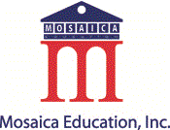
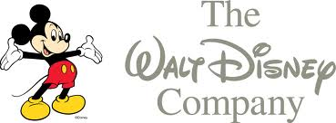
P21 Strategic Council Members
http://www.p21.org
Notes:
These organization serve as strategic council members of P21 and support the P21 mission and framework.

Slide 11
C
reativity
ollaboration
ommunication
ritical Thinking
Notes:
Today, P21 often refers instead to the 4Cs, an easy-to-remember distillation of the original framework, often used as a counter balance to the equally necessary 3 Rs (Reading, WRiting, and ARithmetic).

Slide 12
Basic Literacy
Visual Literacy
Creativity & Innovation
Critical Thinking & Problem Solving
Learning & Innovation Skills
Scientific and Numerical Literacy
Cross-Disciplinary Thinking
Communication & Collaboration
Notes:
Here begins a breakdown of the full set of skills. Lumped into 4 main groupings and then further distinguished into individual skills. See pages 23 & 24 of the 2009 IMLS Publication, Museums, Libraries and 21st Century Skills, to see definitions of each of these skills.

Slide 13
Media Literacy
Information Literacy
Information, Media & Technology Skills
ICT (Information, Communications & Technology) Literacy
Notes:
See page 25 of the 2009 IMLS Publication, Museums, Libraries and 21st Century Skills, to see definitions of each of these skills.

Slide 14
Flexibility & Adaptability
Initiative & Self-Direction
Social & Cross-Cultural Skills
Life & Career Skills
Productivity & Accountability
Leadership & Responsibility
Notes:
See page 26 of the 2009 IMLS Publication, Museums, Libraries and 21st Century Skills, to see definitions of each of these skills.

Slide 15
Global Awareness
Civic Literacy
Environmental Literacy
21st Century Themes
Health Literacy
Financial, Economic, Business, & Entrepreneurial Literacy
Notes:
See page 25 of the 2009 IMLS Publication, Museums, Libraries and 21st Century Skills, to see definitions of each of these skills.

Slide 16
“In the 21st century…expertise is less about having a stockpile of information or facts at one’s disposal and increasingly about knowing how to find and evaluate information on a given topic”
-Douglas Thomas and John Seely Brown, A New Culture of Learning: Cultivating the Imagination in a World of Constant Change (2011)
Notes:
http://www.newcultureoflearning.com/

Slide 17
Why are 21st Century Skills Important?
Notes:
Competencies like critical thinking, global awareness, and media literacy are no longer simply desirable—they are necessary. If 21st century skills are the new design specifications for national and individual success, our nation’s libraries and museums are well-positioned to respond to this need.

Slide 18
“All of these qualities—empathy, discipline, the capacity to solve problems, the capacity to think critically—these skills don’t just change how the world sees you. They change how we see ourselves. They allow each of us to seek out new horizons and new opportunities with confidence—with the knowledge the we’re ready; that we can face obstacles and challenges and unexpected setbacks. That’s the power of…education.”
-President Obama, remarks to Booker T. Washington Graduates, Memphis, TN, May 16, 2011
Notes:
Link to full speech: http://www.whitehouse.gov/the-press-office/2011/05/16/remarks-president-booker-t-washington-high-school-commencement

Slide 19
21st Century Societal Shifts
 | 20th Century | 21st Century
# Jobs/Lifetime | 1-2 Jobs | 10-15 jobs (US Dept. of Labor 2004)
Job Requirement | Mastery of one field | Simultaneous mastery of many rapidly changing fields
Job Competition | Local | Global
Work Model | Routine; hands-on; fact based | Non-routine; technical; creative; interactive
Education Model | Institution centered; forma degree attainment is primary goal | Learner centered; self-directed, lifelong learning is primary goal
Organizational Culture | Top down | Multi-directional (bottom-up, top down, side to side, etc.)
Notes:
This is a table from the IMLS Report Museum, Libraries, and 21st Century Skills (pp 2)
At a time when increasingly advanced skills are required for success in life and work, people of all ages are seeking a diverse range of learning experiences to inspire, guide, and enhance their personal and professional lives.

Slide 20
What are the most important skillsets students leaving high school need to have to thrive in college and life?
Dennis Maple, President of ARAMARK Education, and Larry Merlo, CEO of CVS Caremark Corporation say:
Critical Thinking
Creativity and innovation
Resiliency
Communication
Collaboration
Morning Plenary discussion, 2012 Building a Grad Nation Summit, Washington, DC

Slide 21
“Today's technology-enabled, information-rich, deeply interconnected world means learning not only can – but should – happen anywhere, anytime. We need to recognize these experiences, whether the environments are physical or online, and whether learning takes place in schools, colleges or adult education centers, or in afterschool, workplace, military or community settings.”
Secretary of Education, Arne Duncan, at 4th Annual Launch of the MacArthur Foundation Digital Media and Lifelong Learning Competition (9/15/11)
Notes:
http://www.ed.gov/news/speeches/digital-badges-learning

Slide 22
Recognition of Lifelong Learning
Banks et al. “Learning in and out of school in diverse environments…” Seattle: NSF
LIFE Center and University of Washington Center for Multicultural Education. 2006.
Notes:
All people today—youth and adults—spend the majority of their lives learning outside the walls of formal classrooms: in out-of-school programs, workplaces, internships, and other informal learning experiences such as those offered by libraries and museums.
Referenced article: http://life-slc.org/docs/Banks_etal-LIFE-Diversity-Report.pdf

Slide 23
From “Connected” to “Hyper-Connected”
Back in 2005,
“… ‘Twitter’ was still a sound, the ‘cloud’ was something in the sky, ‘3G’ was a parking space, ‘applications’ were what you sent to college, and ‘Skype’ was a typo.”
From That Used to Be Us (2011) by Thomas Friedman and Michael Mandelbaum
Notes:
In his books, The World is Flat (2005) and That Used to Be Us (2011), Thomas Friedman discusses globalization and the problems America now faces in the current global context. This quote, on page XX of That Used to Be Us, explains the great leaps made in technology since The World Is Flat was published in 2005.
The World Is Flat: A Brief History of the Twenty-First Century is an international bestselling book by Thomas Friedman that analyzes globalization, primarily in the early 21st century. The title is a metaphor for viewing the world as a level playing field in terms of commerce, where all competitors have an equal opportunity.
That Used to be Us: How America Fell Behind in the World It Invented and How We Can Come Back is a book written by New York times columnist and author Thomas Friedman and Foreign policy John Hopkins Professor Michael Mandelbaum, that was published on September 5, 2011 in the United States. It addresses the 4 major problems America faces today and their solution. These problems are: globalization, the revolution in information technology, the nation's chronic deficits, and its pattern of energy consumption
Thomas Friedman is an American journalist, columnist and author. He writes a twice-weekly column for The New York Times. He has written extensively on foreign affairs including global trade, the Middle East, and environmental issues and has won the Pulitzer Prize three times.

Slide 24
Cell Phone & Computers Increasingly Common
% Own cell phone
81
70
43
2002
2007
2010
% Use computer
50
32
39
2002
2007
2010
Based on median % across the 16 nations where 2002, 2007
and 2010 data are available. PEW RESEARCH CENTER Q62 & Q65
Notes:
These charts are from the Pew Research Center Internet and American Life Project.
Other current mobile statistics from MobiThinking website
-There are 5.9 billion mobile subscribers (that's 87 percent of the world population and is a huge increase from 5.4 billion in 2010 and 4.7 billion mobile subscriptions in 2009).
-1.2 billion mobile Web users worldwide
http://mobithinking.com/mobile-marketing-tools/latest-mobile-stats
New Media Consortium: A Communiqué from the Horizon Project Retreat http://www.nmc.org/pdf/2012-Horizon-Project-Retreat-Communique.pdf
The technologies we use are increasingly cloud-based and delivered over utility networks, facilitating the rapid growth of online videos and rich media. Our current expectation is that the network has almost infinite capacity and is nearly free of cost. One hour of video footage is uploaded every second to YouTube; over 250 million photos are sent to Facebook every day. … The Internet is constantly challenging us to rethink learning and education, while refining our notion of literacy. Institutions must consider the unique value that each adds to a world in which information is everywhere. In such a world, sense-making and the ability to assess the credibility of information and media are paramount.

Slide 25
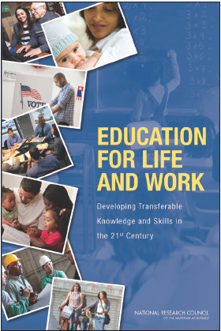
National Research Council Study
Classifies 3 Domains of Competence
The Cognitive(critical thinking, information literacy, creativity)
The Intrapersonal (work ethic, flexibility, initiative)
The Interpersonal (teamwork, collaboration, leadership)
Image: Cover of report, Education for Life and Work: Developing Transferable Knowledge and Skills in the 21st Century (2012), Center for Education, National Research Council
Notes:
The information specific to the three core competencies can be found on page Sum-3 of the report. The three core competencies were developed as a way to organize the various terms for “21st century skills” and provide a starting point for further research as to their meaning and value
Other key information from the study:
*Several Foundations charged the National Research Council to define the set of key skills that are referenced by the labels “deeper learning,” “21st century kills,” “college and career readiness,” “student-centered learning,” “next generation learning,” “new basic skills,” and “higher-order thinking” and then to summarize the findings of the research that investigates the importance of such skills to success in education, work, and other areas of adult responsibility.
The committee’s work for this report was supported by Carnegie Corporation of New York, the William and Flora Hewlett Foundation, the John D. and Catherine T. MacArthur Foundation, the National Science Foundation, the Nellie Mae Education Foundation, the Pearson Foundation, the Raikes Foundation, Susan Crown Exchange, and the Stupski Foundation.

Slide 26
The 21st Century Museum/Library Shift
20th Century Museum/Library | 21st Century Museum/Library
Primarily content driven | Combination of audience and content driven
Mostly tangible objects | Tangible and digital objects
One-way | Multi-directional
Focus on presentation and display | Focus on audience engagement, experiences
Acts independently | Acts in highly collaborative partnerships
Located in community | Embedded in community
Learning outcomes assumed, implied | Learning outcomes purposeful
Notes:
In light of 21st century demands, libraries and museums should build on current strengths and embrace new approaches such as the ones described in the chart. This chart has been amended slightly from the original version to fit to the PowerPoint. For the full chart, see page 7 of the Museums, Libraries and 21st Century Skills publication.

Slide 27
“All libraries and museums—and the people they serve—stand to benefit from becoming more intentional and purposeful about accommodating the lifelong learning needs of people in the 21st century, and doing this work collaboratively in alignment with community needs.”
From Libraries, Museums, and 21st Century Skills, IMLS (2009), pp. 7

Slide 28
Where can I find more information about 21st Century Skills?

Slide 29
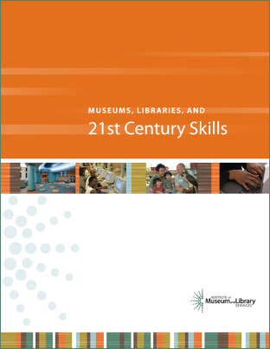
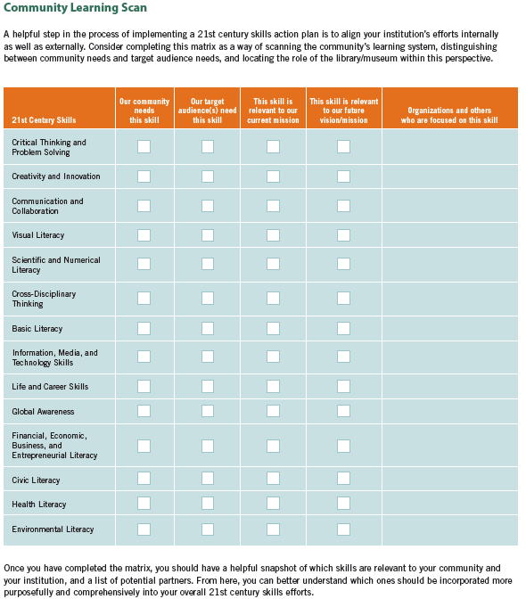
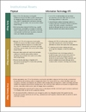
IMLS Resources
http://www.imls.gov/21stCenturySkills
Museums, Libraries and 21st Century Skills publication
21st century skills podcast
Community workshop toolkit
Self-assessment tool
Community learning scan
Information about successful IMLS-funded projects involving 21st century skills
Resource bibliography

Slide 30
Other Useful Resources
For a list of other useful resources, please visit the “other resources” tab of the IMLS 21st Century Skills website to find a list of helpful links and a bibliography of current research and reports. www.imls.gov/21stcenturyskills

