Slide 1
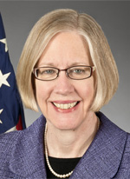



Reboot Your Digital Strategy!
Susan Hildreth
Institute of Museum
and Library Services
Heidi Silver-Pacuilla
U.S. Department of Education, Office of Career, Technical,
and Adult Education
Sandra Toro
Institute of Museum
and Library Services
Amber Petty
Everyone On!
Notes:
Welcome to Reboot Your Digital Strategy! I am Steve Quann, the Instructional Technologist for the LINCS Region 1 Professional Development Center, a project of World Education, Inc. LINCS is a professional learning community for adult educators, funded by the Office of Career, Technical, and Adult Education (OCTAE), U.S. Department of Education. OCTAE and the Institute of Museum and Library Services (IMLS) have been working together to enhance the skills, employability, and quality of life of youths and adults with low skills, with a particular focus on improving digital literacy. This webinar highlights those efforts and will cover national initiatives, resources, and tools that adult educators and librarians can use to enhance their digital literacy programming and services.
We are very fortunate to have as our presenters today:
• Susan Hildreth, Institute of Museum and Library Services
• Heidi Silver-Pacuilla, U.S. Department of Education, Office of Career, Technical, and Adult Education
• Sandra Toro, Institute of Museum and Library Services
• Amber Petty, Everyone On!
I would now like to turn things over to my colleague at World Education, Ben Bruno, who will explain the interactive features you can use to enhance your webinar experience.

Slide 2


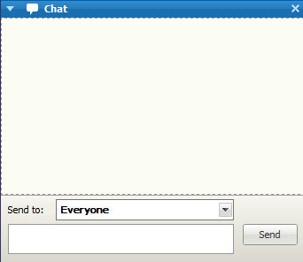

Online Meeting Features
Use chat box for discussion
Please remain muted!
Use chat box for discussion
Send chats to everyone
Send chats to everyone
Notes:
Explain how to use the features on the slide. Say that a recording and PDF of slides will be available after the webinar.

Slide 3

For what type of organization do you work?
Photo: freeimages.co.uk
Notes:
Tell participants you would like to take a quick poll so the group gets an idea of what types of organizations are represented. Give instructions on how to access and respond to the poll. If using Poll Everywhere, provide Poll Everywhere number and web address for the poll you created.
Summarize poll results. If using Poll Everywhere, have the results on your browser and share your screen.

Slide 4

Introductions
What is your name, position, and organization name and type?
What is a digital literacy challenge you are hoping to address at your organization?
Notes:
Have participants respond to the prompts on the slide. If using Today’s Meet, demonstrate how to access your Today’s Meet page and reply to the prompts, and say: While you’re doing that, I’m going to move to the next slide to show you some topics that we’re going to be covering, and I expect we’ll see your responses reflected there.

Slide 5
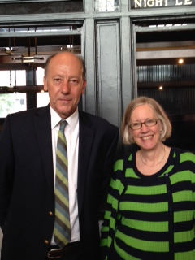
Introduction
The Institute for Museum and Library Services (IMLS) and the U.S. Department of Education’s Office of Career, Technical, and Adult Education (OCTAE) are working together.
IMLS Director Susan Hildreth and OCTAE Acting Assistant Secretary Johan Uvin while attending the Clinton Global Initiative (CGI).
Notes:
Welcoming remarks by Susan Hildreth regarding the joint letter. (The Institute for Museum and Library Services (IMLS) and the U.S. Department of Education’s Office of Career, Technical, and Adult Education (OCTAE) are working together to encourage effective collaborations between libraries and federally funded adult education programs to help more Americans take advantage of the educational, employment, financial, health, social and civic resources that are available online… Joint activities include: increasing awareness about resources and training (see http://LINCS.ed.gov); developing literacy tutorials and guides; and collaborating with various associations and nonprofits to identify and disseminate examples of partnership activities the public adult education system and libraries are taking at the state and local levels.)

Slide 6

Brainstorm:
What are your greatest technology challenges? Enter them in the chat window.
Notes:
Brainstorm:
What are your greatest technology challenges? Enter them in the chat window.

Slide 7
Why are adults not online?
Access
Digital Literacy
Affordability
Digital literacy
Affordability
Relevance
Ease of use
Confidence
Access
Confidence
Ease of use
Relevance
Notes:
Say: Why are adults not online? Cost is certainly part of the reason, and 19% of those surveyed for the Pew Who’s Not Online and Why? report (Zickuhr, 2013) indicated that price (of computers, upkeep, and internet service) was part of the barrier; however, this was no longer the primary reason as it had been in Pew’s 2000 edition of the survey. In the 2013 survey, 34% cited lack of relevant content, 32% cited reasons related to the perception that the internet is not easy to use or maintain securely – the “hassle factor” - and only 7% cited lack of access or availability. This presentation will give you some ideas of how to break down digital literacy strategies into component parts and try new ideas in your program or classroom.
If using Today’s Meet, have the poll in Projector mode, share your screen, and highlight several chat responses and how they match with the reasons listed on the slide.

Slide 8
ACCESS
Notes:
Say: Digital strategies have to start with access, but what does that mean?

Slide 9
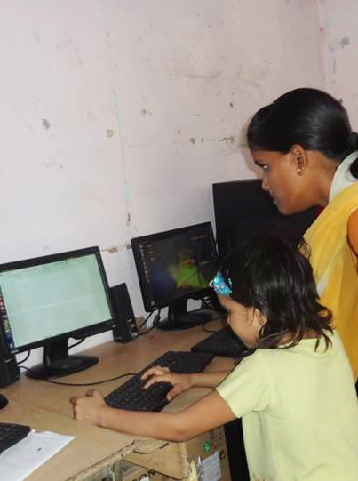
Access to what?
Internet, wired and Wi-Fi
Broadband
Cell service
Data and text cell phone plans
Computer and printer
Power and memory
Projectors for classrooms
High-quality content
Digital literacy training
The future!
Photo: World Education, Inc.
Notes:
Say: Access can mean many things. This list provides quite a few ways to think about access:
Internet, wired and Wi-Fi
Broadband
Cell service
Data and text cell phone plans – unlimited data and text plans open a new world of exploration without concern for overages
Computer and printer – some pubic access terminals are not connected to a printer, so students cannot leave with an artifact.
Power and memory – some public access terminals don’t allow users to save anything. That can be very frustrating to learn to work around.
Projectors for classrooms – if you only have one computer in the class, how do you work together? You have to have a projector.
High-quality content – what are we providing access to? Hopefully high quality content that is engaging, adaptive, interesting, challenging, and so on.
Digital literacy training – you can’t use what you don’t understand, so digital literacy training is step #1. And it becomes important at many points in our digital learning. How did you learn the last new trick? Chances are learned it with a colleague, a teenager, or a grandchild. We are all still learners.
We will provide more information about how libraries fill the role of digital access and training in communities around the country.

Slide 10
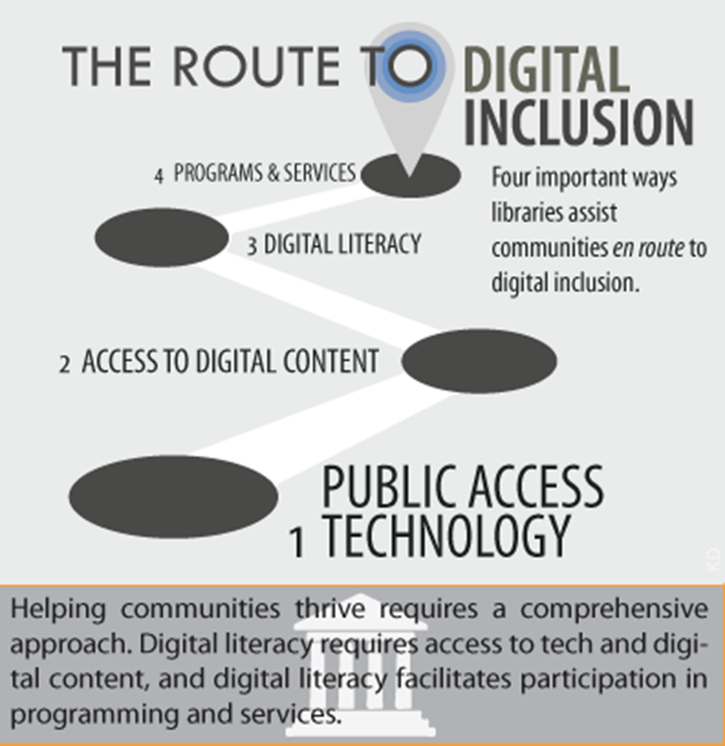
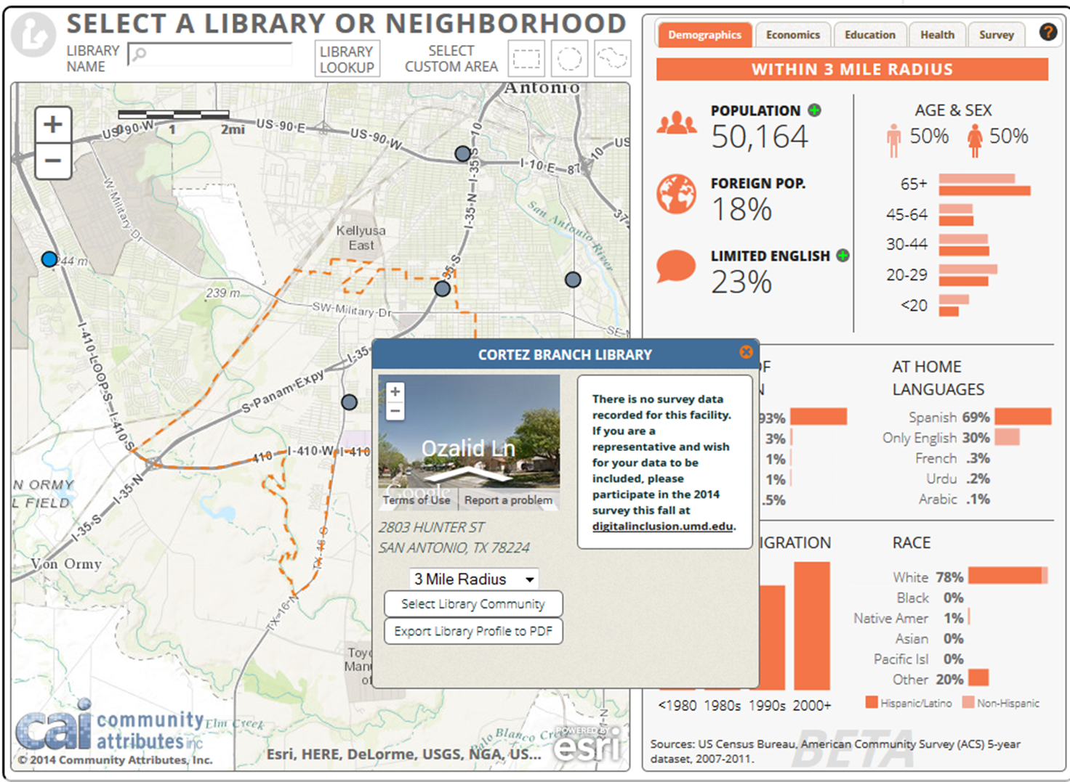
Learning More about Digital Inclusion
IMLS Office of Planning, Research, and Evaluation working with the University of Maryland and the American Library Association
Notes:
Say: When we think about digital inclusion, we are talking about the ability of individuals and groups to access and use information and communication technologies. IMLS funded the Information Policy & Access Center at the University of Maryland and the American Library Association (ALA) Office for Research and Statistics to develop the Digital Inclusion interactive map. This data visualization tool maps all public libraries using the FY2011 Public Library Survey data file. The tool overlays Census data (demographic, economic, health, and education) from the American Community Survey (ACS) 5-year dataset (2007-2011). Selected Digital Inclusion Survey data from participating libraries is also included on the map, thus showing the roles that libraries play regarding digital inclusion in their communities. The International City/County Management Association and the ALA Office for Information Technology Policy serve as partners on the grant.

Slide 11

Access
Working with libraries
  OCTAE working closely with Institute of Museum and Library Services (IMLS)
  16,500 public libraries in the U.S.
  77M people used the library for computers and Wi-Fi access in 2009
  42% of library computer users cite education as their main reason
    24% were taking an online course or assignment
  (Becker, Crandall, Fisher, Kinney, Landry, and Rocha, 2010 )
Where is access to computers and internet in every community?
Notes:
Say: The report, Opportunity for All, also cites that 42% (estimated 32.5 million) of library computer users indicate that education is the reason they are online, and 24% of those users reported taking online courses or working on online assignments.

Slide 12
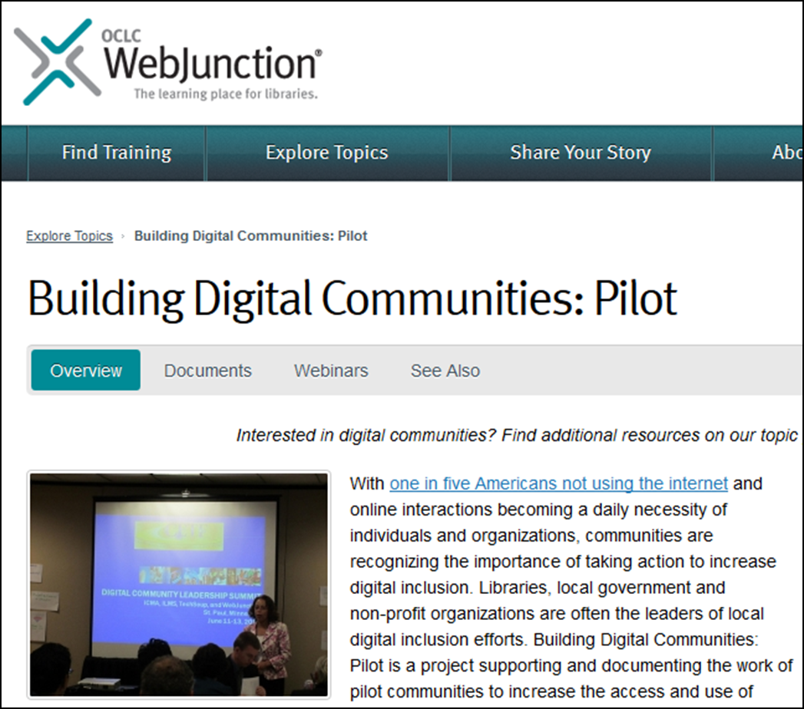
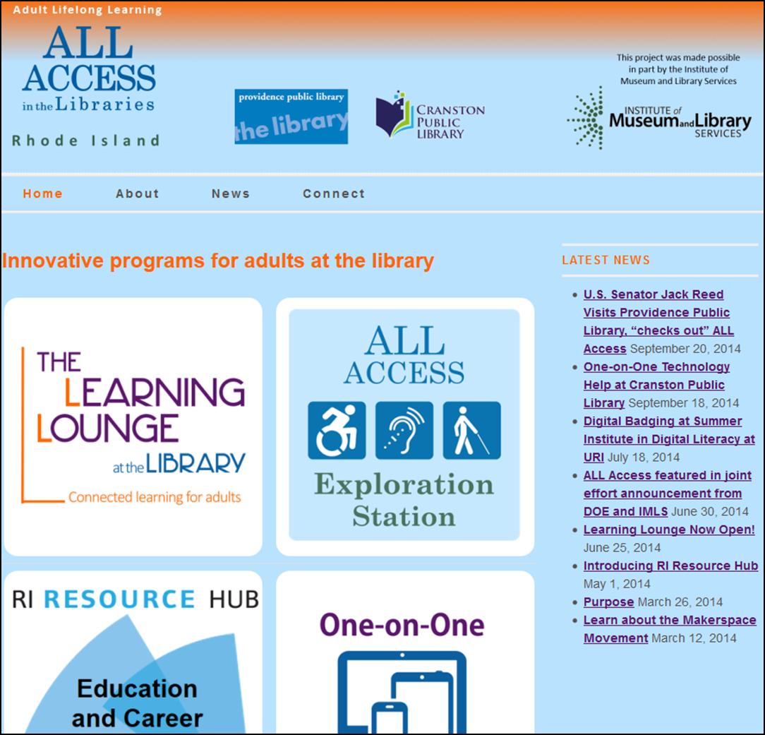
Increasing Access
IMLS is working to help prepare librarians to lead digital inclusion efforts.
Notes:
Say: IMLS has been working with librarians on digital inclusion. WebJunction is an online learning community for librarians that promotes learning for all library staff funded with $457,958 from IMLS. Since 2003, WebJunction has helped more than 80,000 library staff build job skills. WebJunction offers webinars and courses as well as information about competencies and resources for learners. Librarians can find documents, articles, handouts, webinar archives, links to other online services and information, plus the latest news on everything from communication to digital inclusion to workforce services, e-rate, and web design. In 2011, IMLS awarded a grant of $249,871 to WebJunction for a project aimed at helping communities across the country with digital inclusion. The project will complement IMLS’s efforts to help libraries and other community-based organizations (CBOs) make strategic decisions about providing public access to broadband. Working with its partners, TechSoup Global, and the International City/County Management Association (ICMA), OCLC’s WebJunction started working on evaluating the needs of libraries, CBOs, and city and county managers seeking to get started with digital inclusion. Using the findings, the partners created an action plan and have been providing resources online at WebJunction, TechSoup Global, and ICMA’s Knowledge Network. In addition, partners are evaluating and publishing outcomes, and jointly reporting to IMLS on project effectiveness and lessons learned. Another example is an award to Providence RI Public Library ($498,172) Two of the largest public libraries in Rhode Island and its committed statewide partners are being supported to demonstrate models and methods for integrating library, adult education, and workforce services through the library to support adults with low education attainment; low English-literacy; disabilities; and/or low digital literacy. Their needs cannot be met by the current workforce and adult education systems alone.
Say: ALLAccess is designed to help adults overcome barriers to access in education and workforce services for all adults; develop, expand and improve statewide resources for adult online learning and workforce development; establish effective models to deliver and support education; and build a data-driven case for libraries’ role in providing adult education and workforce services.

Slide 13
What does digital literacy education in libraries look like?
School librarians can help children develop basic digital literacy competencies
IMLS-funded Learning Labs help young adults gain more advanced knowledge and skills for coding, digital storytelling, and game design
What about adults? Libraries provide:
  learning opportunities outside K-12 educational system
  computer classes & self-directed tutorials to use onsite or at home
  The District of Columbia Public Library offers a General Equivalency Diploma (GED) institute to help better prepare instructors who teach adults who struggle with preparing for the GED exam.
Notes:
Say: What does digital literacy education in libraries look like? School librarians can help children develop basic digital literacy competencies.
IMLS-funded Learning Labs help young adults gain more advanced knowledge and skills for coding, digital storytelling, and game design.
What about adults? Libraries provide learning opportunities outside K-12 educational system and computer classes & self-directed tutorials to use onsite or at home. The District of Columbia Public Library offers a General Equivalency Diploma (GED) institute to help better prepare instructors who teach adults who struggle with preparing for the GED exam. Also, the Santa Ana Public Library, in partnership with HistoryPin, is working with new immigrant communities to increase digital literacy and provide learning in STEM (Science, Technology, Engineering and Math) through digital training in new media and digitization tools. And, the Alele Museum, Public Library and National Archives has an intergenerational digital literacy program for the island’s aging population and youth. The library is paying for newly available fiber connectivity to bring higher bandwidth to library users to enhance their use of databases, e-books, online journals, and regularly scheduled virtual tours. Alele is also offering computer classes and book lending services at the local Retirees Center.

Slide 14
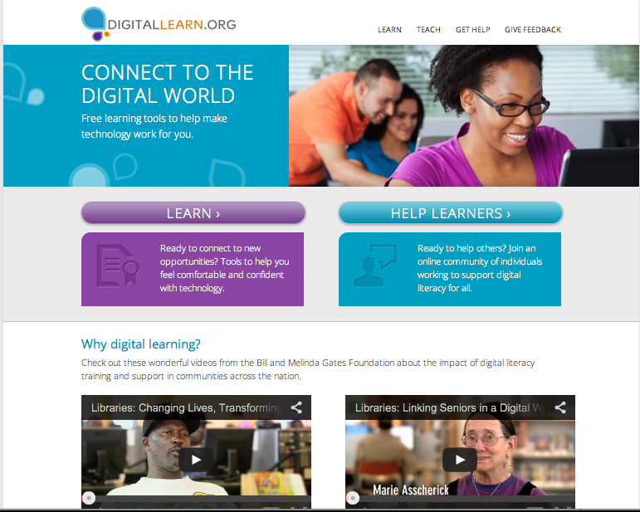
Digital Learn
Notes:
Say: One resource worth bookmarking is DigitalLearn.org, funded in part by the American Library Association and IMLS. This site has a wide collection of mini-modules that students can use to learn targeted skills in very short timeframes. These modules are helpful to tutors to use for learning, or for learners to use on their own. DigitalLearn.org was created as a tool to support organizations that are increasing digital literacy and empowering learners. The beta site for DigitalLearn.org was launched March 21, 2013, in conjunction with the launch of the EveryoneOn Ad Council campaign from Connect2Compete and the full site launched at the ALA conference in June 2013. The site delivers end-user resources so that organizations can meet the demand for just-in-time online e-learning and provides access to a community of practice for digital literacy trainers where people share resources and connect with others in the field. DigitalLearn.org has surpassed all usage goals and adoption continues to increase. The proposal assumed 10,000 unique visitors in the first year; during that first year the site had 36,667 visitors and has had 66,610 unique visitors in the 20 months since the beta site launched. All 50 states and Washington, D.C., have used the site, and there are 1,874 total links to DigitlaLearn.org coming from 160 different domains. Additionally, the goal in the first year was 1,000 class completions; during the first year the site had 5,914 class completions and has had 13,019 class completions in the 20 months since the beta site launched.

Slide 15
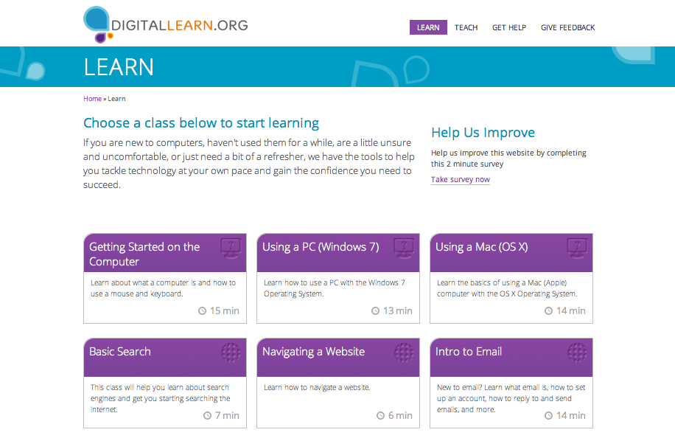
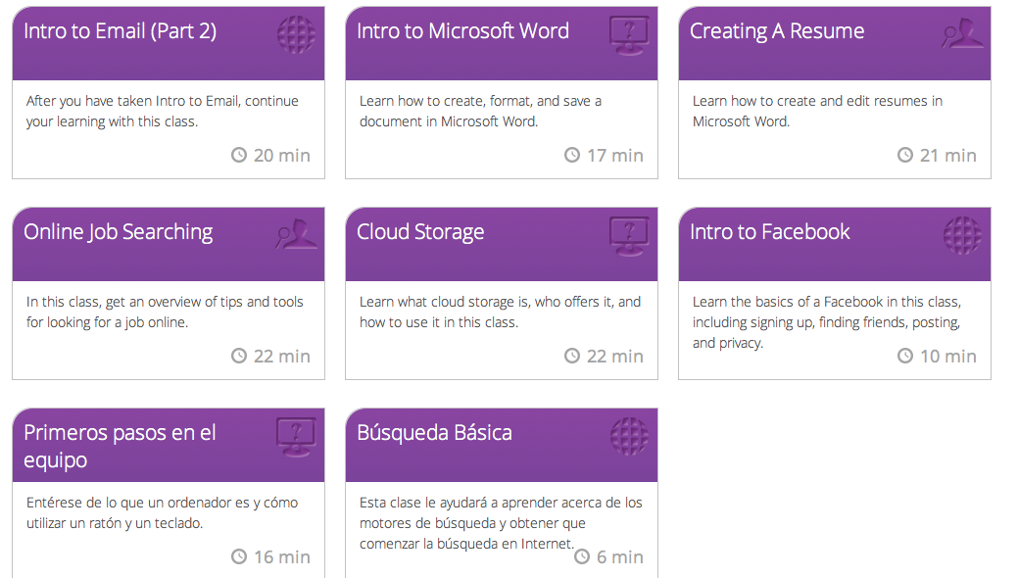
Digital Learn Classes
Notes:
Say: This is a selection of the available modules on basic digital literacy skills that range from 5 to 22 minutes. More modules in Spanish are being added now.

Slide 16
AFFORDABILITY
Notes:
Say: As we mentioned earlier, cost remains a barrier to digital access for many people. One way the Office of Career, Technical, and Adult Education is working to help adults and families break down these barriers is through promoting awareness of efforts such as EveryoneOn.org. Next, we will review what its program can offer.

Slide 17
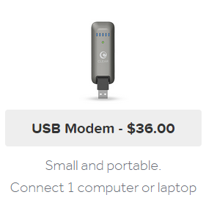
EveryoneOn
EveryoneOn.org/adulted
Prequalifies for the best deal in the local area:
  Students
  Teachers
  Programs
Wireless internet service for as low as $10 a month
Refurbished tablets, laptops, desktops
Downloadable materials:
http://everyoneon.org/campaign-materials/
Let’s get more devices in students’ hands and households.
Notes:
Say: Here is some background about Everyoneon: it's a national non-profit working to eliminate the digital divide by providing low cost internet options to unconnected Americans. EveryoneOn does this in a variety of ways. One is by leveraging partnerships with internet providers to get affordable options for its constituents. It has two types of offers, wired and wireless.
Wired offers are more for individuals who have families with students who qualify for national school lunch programs. Wireless offers are for anyone living in pre-qualified zip code. This means anyone living in a low-income zip code area, qualifying at $35,000.
A second way EveryoneOn qualifies individuals is through organizations such as OCTAE. OCTAE's portal is everyoneon.org/adulted. With this, EveryoneOn is able to pre-qualify anyone coming through OCTAE’s portal. EveryoneOn works with a lot of non-profits, school districts, and housing authorities, to get their constituents pre-qualified.
Most of the internet offers are around $10 a month, with a set up cost of the router, which is about $40.
In addition to wireless and internet offers, EveryoneOn also offers discounted desktops, tablets, and laptops through other partners.
For helpful materials such as flyers in English and Spanish, a sign-up guide, an internet basics curriculum, and more, visit the Campaign Materials section of the site.

Slide 18
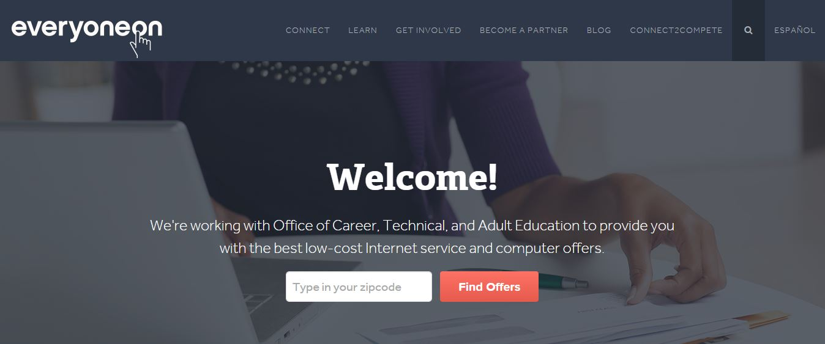
EveryoneOn/adulted.org
Notes:
Say: This is an example of adult education's portal on EveryoneOn’s website. As organizations sign up as enrollment partners, they get their own log-ins. The organization can sign people up through its own site. Individuals enter their zip codes and then click “Find Offers.” They are prompted to answer a few questions, and then immediately find out which offers are available in their location.

Slide 19
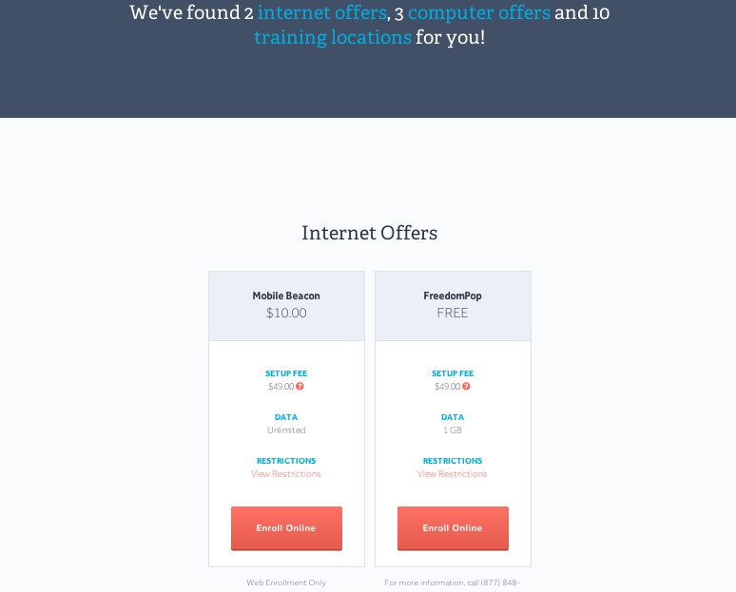
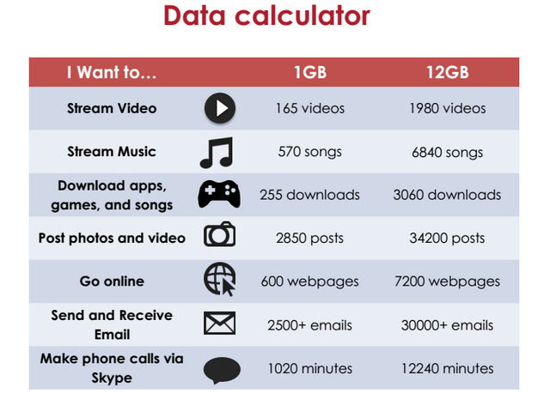
Internet Offers
Notes:
Say: This is an example of the offers you would get. These are two of the more popular offers:
The Mobile Beacon offer is $10 a month for unlimited data, plus the cost of the router.
FreedomPop is completely free, just having the cost of the router. It gives 1 gigabyte, and it's completely free.
To make it clearer as to what having that amount of data means, this data calculator shows what someone can get with 1 gigabyte and with 12 gigabytes. For example, with 1 gigabyte, it’s possible to stream approximately 570 songs, view 600 webpages, and send 2500 emails.

Slide 20
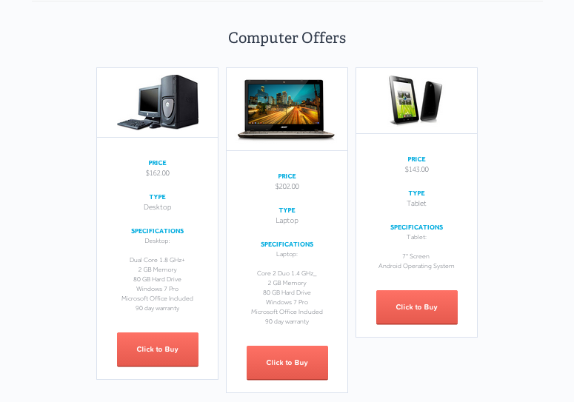
Computer Offers
Notes:
Say: Here are a few computer offers, because EveryoneOn realizes that having a device is often a barrier as well. Most range from $162 on the high end for a desktop computer; some offers are lower. There are laptops for between $150 to $200. Tablets were recently added as more people are moving to that platform.
Most devices are simple to set up– plug them in and you’re good to go. EveryoneOn provides instruction for enrollment partners and then provide training so partners can train people who come in through their system.
If individuals needs extra help, depending on which offer they decide to go with, they can call in to the support number and get transferred to support staff.

Slide 21
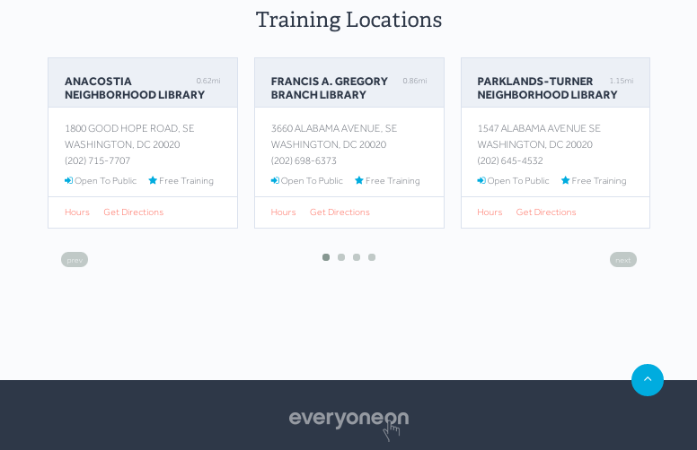
Training Locations
Notes:
Say: The third way EveryoneOn is helping to bridge the digital divide is by linking people with classes that will help them to gain the skills they need to be digitally literate. On its site, libraries sign up as a training location. The libraries put in their classes, their hours, and contact information. As constituents sign up for internet access, based on their zip code, the site will recommend classes near them.

Slide 22
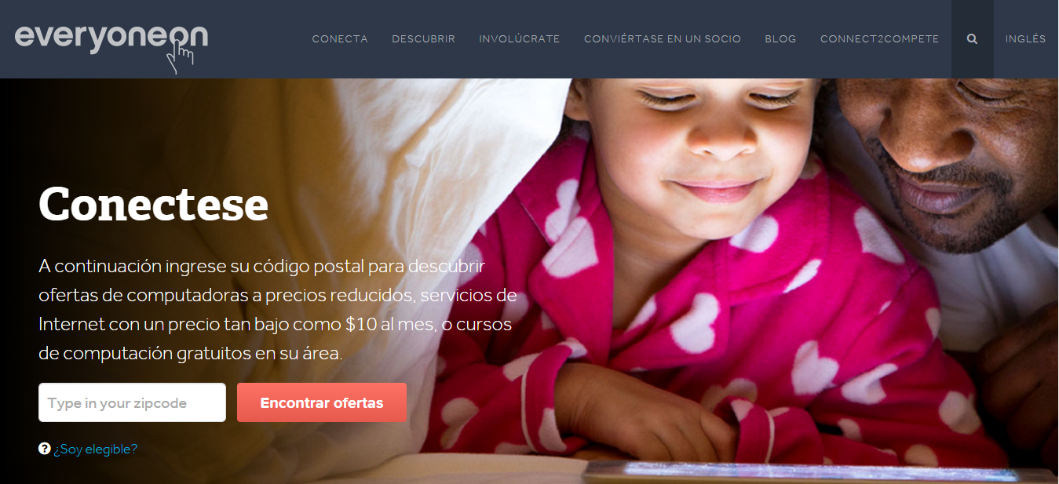
In Spanish
Notes:
Say: Many people say language can be a barrier. The EveryoneOn site is available in Spanish, as are most of the sites linked in its knowledge center. So if constituents are looking for a resource, for example, online banking, most of the sites linked through its platform will be available in Spanish as well.

Slide 23
EASE OF USE
Notes:
Say: As mentioned earlier, in the 2013 Pew Internet and the American Life survey, ease of use or what could be called the “hassle”, barrier is growing. Making a good choice about a device or data plan to purchase or setting up and maintaining security for a home network isn’t easy. And for people with disabilities, it can be difficult to get the information via the Internet in a mode that they can easily use.

Slide 24
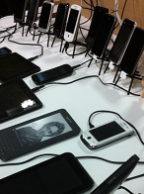
Bring Your Own Device
Bring Your Own Device (BYOD)
Pros:
  People are familiar with own device
  Can continue to work after class
  No need to provide equipment
  Any space can be a digital learning environment
Cons:
  May need specialized tech help
  Incompatibility of soft or hardware
  Wireless connectivity
  Security concerns for network
Not everyone is a network administrator!
Photo: Jeremy Keith
Notes:
Say: Many of our adult education programs do not have the capacity to provide a one-to-one or in-classroom laptop program. Allowing students to bring and use their own devices can go a long way toward bringing technology into the learning environment. Wireless routers from EveryoneOn can help turn a classroom into a wired learning environment. But there are important considerations to this approach.
Pro’s include:
People are familiar with own devices.
Students can continue to work after class.
There is little need to provide equipment.
Any space can be a digital learning environment.
All of these are compelling reasons to try this approach. Students do not all need to have the same device. Students can even pair up quite successfully if not everyone has a portable device. There is a lot of communication practice that happens when students are sharing devices and learning together – and when students are talking about their device being similar or different than their peers’.
However, there are some con’s to this approach:
You, as the teacher, may need specialized tech help at least to start.
Some devices may be incompatible with some of the software or hardware, and not all sites render the same on different devices so students may be seeing things slightly different.
Wireless connectivity is not always as robust as one would hope.
There may be security concerns for your program network, so be sure to talk to your administrator.

Slide 25
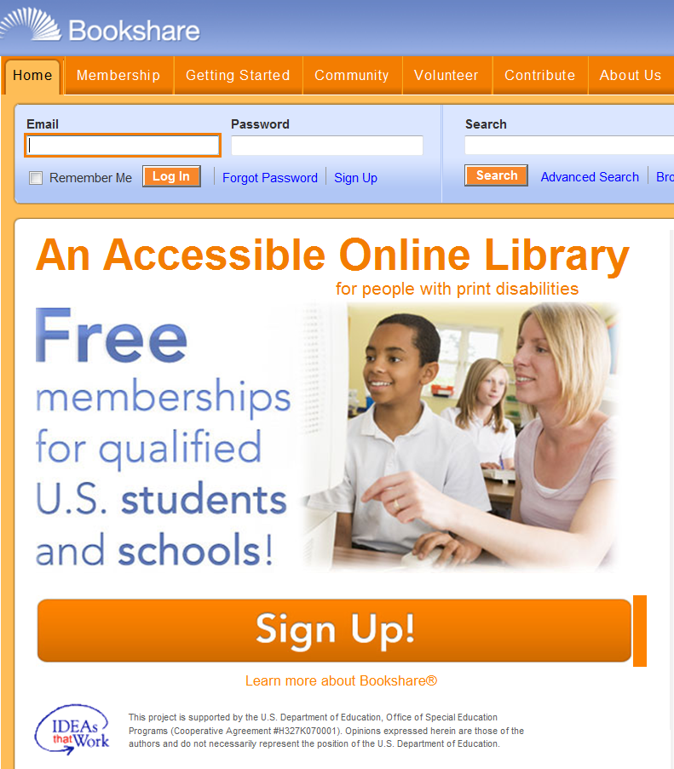
Bookshare
Bookshare membership offers:
  Access to digital text that is delivered in custom formats such as audio, customizable text, digital Braille
  Reading software that facilitates study with annotations, dictionary, spellcheck, pronunciation guide
  Access to a library of over 300K materials
Membership is for adults with print disabilities such as visual, physical, or severe learning disabilities.
Notes:
Say: OCTAE is working with Benetech to inform youth and adult students with visual, physical, and learning disabilities that they may be eligible for no-cost memberships to their Bookshare service. Bookshare membership offers access to digital text that is delivered in custom formats such as audio, customizable text, and digital Braille, and more; reading software that facilitates study with annotations, dictionary, spellcheck, and pronunciation guide; and access to a library of over 300,000 materials. Bookshare is funded in part by the Department of Education through the Office of Special Education and Rehabilitation Programs. The program addresses the critical aspect of timely access to print for students’ success in academic and occupational settings.

Slide 26
RELEVANCE
Notes:
Say: Among people who are not online, lack of perceived relevance is another barrier that keeps them from getting online.

Slide 27

Relevance
“Much good content remains largely invisible to students.” (p. 7)
  Create a culture of sharing resources with students.
  Integrate apps and online activities into supplemental assignments.
  Encourage students to share resources with family and friends.
How do you find good content for supplemental and
self-study?
Notes:
Ask participants to read the question in the gray box: How do you find good content for supplemental and self-study for your students?
If using Today’s Meet, direct students to your page, share your screen with the results, and read a few participant comments.
Say: The good news – and the bad news – is that the internet is so rich. You can find information about nearly anything! Or can you? Effective searching is becoming a critical skill in order to get search returns that are on target. This is true for us as much as it is for students.
I am struck by a quote from this referenced report that “much good content remains largely invisible to students.” Why is that? We have to help get our students connected to the wealth of information that they could be learning from in and out of class.
Say: Taking on this challenge is also an opportunity to ask students directly what they are interested in; you are likely to be surprised.
Share an example, such as: I was surprised by one student who had a great interest and knowledge in classical art. An elementary school teacher had given her a coffee table art book that she had cherished and studied through the years. When she got online, what she wanted to do was to visit museum sites and learn more about classical art. I learned a lot working with her! She and I also found related museum sites for her children. They could start sharing her interest and learning together.

Slide 28
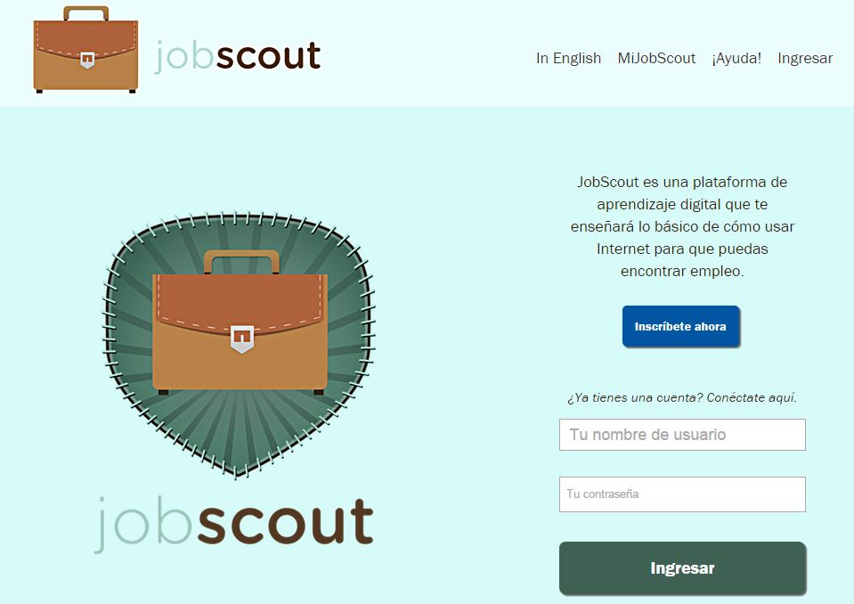
Relevance
Job Scout offers:
  No cost access to job listings, aggregated by SimplyHire
  No cost portfolio to save listings and resumes
  Digital literacy tutorials
  Social media platform
  Badges that reward progress
  Fully available in English and Spanish
  www.myjobscout.org
Over 80% of companies post job openings only online (Levere, 2013).
Notes:
Say: Job search is a very relevant activity for many of our students. We discussed earlier how many adults use the libraries for job searches. This freely available site, Job Scout, was field tested in the California Library Literacy system. It is designed for low-skilled readers in English and Spanish. It offers a wealth of features to assist with job searches, including
No cost access to job listings, aggregated by SimplyHire
No cost portfolio to save listings and resumes
Digital literacy tutorials
Social media platform
Badges that reward progress

Slide 29
CONFIDENCE
Notes:
Say: Confidence comes with practice, practice, practice and solving multiple problems.

Slide 30
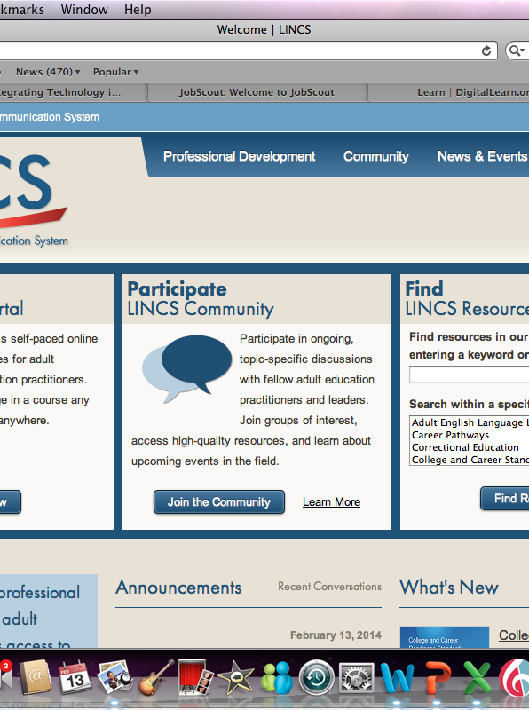
Confidence
LINCS Learning Portal
  17 self-paced, no cost courses
    Career Pathways
    Adult ESL
    Integrating Technology
    Learning to Achieve
  Facilitated courses offered in cooperation with states and programs
  Certificates of completion
  Links to Community groups
  Currently hosts over 2K users
Grow yours!
Try a LINCS online course.
Join a community group.
Notes:
Say: Let’s switch to thinking about us as practitioners and our confidence to do more with technology for our students. The LINCS site is one place where you can grow your experience and confidence. At LINCS, you can find 16 topical Community Groups where you can discuss issues with peers and experts. There is a collection of vetted and reviewed resources, organized into the same 16 topical categories that are a good place to start when looking for resources for yourself or your students. At the LINCS Learning Portal, you can find
17 self-paced, no cost courses in topics such as
Career Pathways
Adult ESL
Integrating Technology, and
Learning to Achieve, or how to serve students with learning disabilities
Facilitated courses are offered in cooperation with states and programs.
And all of the courses offer certificates of completion if you are meeting continuing education requirements.

Slide 31
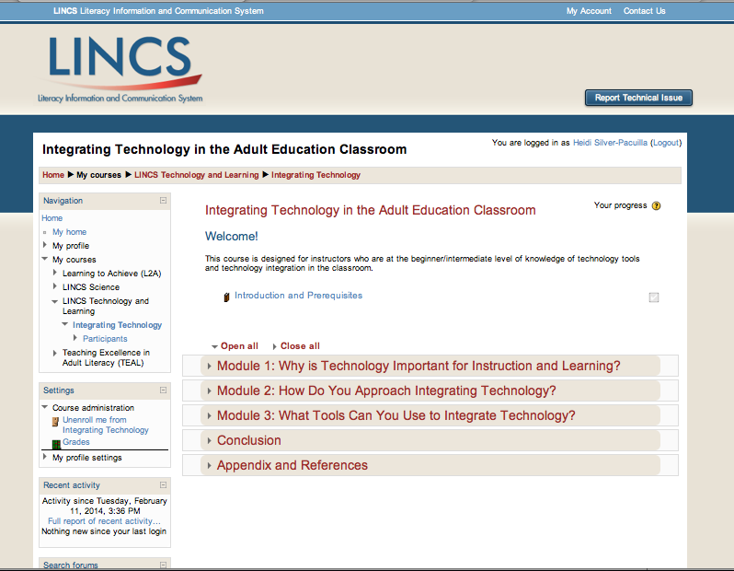
Integrating Technology Online Course
Notes:
Say: This course is particularly relevant to our discussion—Integrating Technology. This self-paced course will provide you with a solid understanding of why, how, and what to integrate with many links to new resources and ideas to try tomorrow. It is closely linked to the community of practice through reflection questions, so you will be able to raise questions and engage in group discussion even though you are not taking the class in a cohort.

Slide 32
PLANNING AND EXTENDING
Notes:
Say: Now that we’ve talked about so many aspects of digital literacy, what are you going to do about it? You may be wondering how to best direct your limited energy and resources.

Slide 33
Who’s Online Where (WOW) Index
A planning tool from OCTAE to help identify best bets by county for extending online programming
Who’s Online Where Index
  Adult ed target population by county
  Households earning >$25,000
  Home internet use estimate
  Household broadband estimate (urban/rural/suburban)
  Public libraries
  Community anchor institutions (Job Centers, etc.)
http://www2.ed.gov/about/offices/list/ovae/pi/AdultEd/extending-abe-with-wow.pdf
Notes:
Say: OCTAE has assembled a tool to help programs and state leaders look across their states or regions and take all the considerations into account to help plan expansion of digital learning efforts.
This tool consists of
a short report on the state of connectedness among the adult ed target audience;
links to available data sets that can help determine connectivity;
vignettes of digital strategies in various locations;
a fully developed Index of Ohio, including the datasets by county and accompanying maps to illustrate the power of putting all these data points together; and
an Excel workbook with instructions and embedded formulas for creating an Index.
The WOW Index layers all the data points listed here, constructing an Excel sheet or a map that can make visible which areas are most likely to be able to support technology-enabled expansion of adult education services because there is enough need, broadband coverage, and public access points at community anchor institutions.

Slide 34
RESEARCH AND RESOURCES
Notes:
Say: As this workshop comes from the U.S. Department of Education, we would be remiss if we did not have a section on research and what we know about learning that makes digital learning such an important component of what we do with adult students.

Slide 35

Lessons from learning science
Active
Deep
Social
Personalized
Contextualized
Trial and error
Practice
https://10innovations.alumniportal.com
Notes:
Say: This list captures a lot of what we know makes quality learning experiences for youth and adults.
Active refers to hands on, experimental labs, creating content through authentic, project-based and problem-based learning.
Deep refers to constructing and creating content, and learning how to apply strategies.
Social refers to blended and interactive models. It includes dialogue with peers and facilitators, mentors, and coaches and learning communities so students are articulating in their own words and voice what they are learning. It’s also critical to learn to ask for help, this is a big part of being self-directed, knowing when and where to seek external assistance.
Personalized does not mean independent and alone, but adaptive and targeted through learning analytics and diagnostic assessments to remediate specific gaps and accelerate where the student is strong
Contextualized means that learning is tied to something immediately relevant to the student, a problem or project or occupational training.
Trial and error—we are humans after all! Learning is a personal process and has to be experienced for oneself.
Practice refers to the understanding that skills require practice to get to a level of fluency. There is no short cut. To move a skill out of working memory (where you are still talking yourself through every step) into fluency, it simply has to be practiced dozens and dozens of times. Help students learn how the brain works to understand why practice is so important.

Slide 36

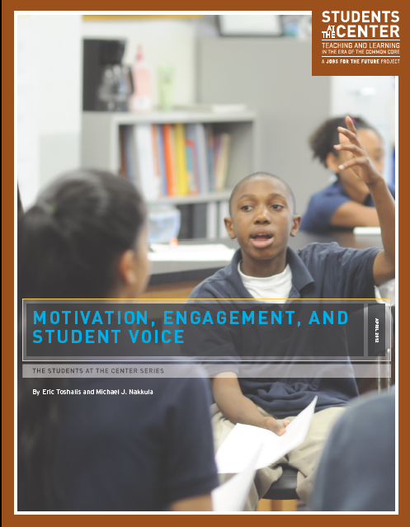

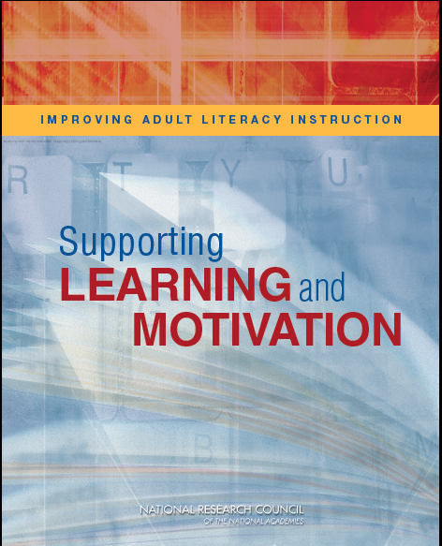

Research briefs
Notes:
Say: This slide shows five, very approachable, practitioner-friendly briefs that summarize large bodies of research. We highly recommend these briefs as a way to understand and share with your colleagues what you are learning about learning. I’ll give you just a taste of each one. The links to them are on the next slide, so you will have them.
[Click to show each resource as you describe them.]
The Education for Life and Work brief summarizes a book by the National Academies of Science that looked at how to teach and learn 21st century competencies, which it discusses as cognitive, interpersonal, and intrapersonal knowledge and skills. Sometimes these latter two are called “non-cognitive” skills, or more popularly, recently, as “grit.”
The brief discusses Deeper Learning, which is described as developing transferable knowledge, such as that exhibited by experts, which takes time and focus and requires many opportunities for practice—especially practice with feedback.
Supporting Learning and Motivation is a 3-part booklet drawn out of the larger book-length report also by the National Academies of Science called Improving Adult Literacy Instruction. This short report is for practitioners and speaks to instructional designs that are supportive, methods to build intrinsic motivation and persistence, and technology features that support the pedagogies.
Fueling the Race is a report on prior learning assessments or PLA. The authors looked at 62,000+ students at 48 institutions in this multiyear study. Findings include students who had some credits granted through PLAs had better academic outcomes, particularly higher graduation and persistence rates, and took less time to degree. Honoring and giving credit for what students already know is a huge boost and a real concrete way to personalize their trajectory.
Student Voice: As you can imagine, voice is strongly related to many of our key learning terms. This is a great read, very approachable and guaranteed to make you think about how you are managing and running your class or program and how much leadership you are allowing and nurturing in your students.
This last one is from the Stanford Center for Opportunity Policy in Education. It has very practical suggestions about how to use technology to support struggling learners, and why struggling students need their own devices.
Let me say a little about this since we have talked about access, affordability, relevance, and confidence. Students from low income families are likely not to have had their own device for as long as students from middle and upper income families where one on one computing with super fast internet speeds is the norm. In terms of time on practice and trial and error with digital learning, our adult education students are usually way, way behind. In fact I just heard of a study that found the same thing with 13 year olds. Those from low income families where there was one or no home computer lagged behind in digital savvy than their peers. It’s so obvious. You and I have learned so much in the years that we’ve been using computers—about how to manage our email, keep track of things to read later, how to enlarge the font or customize the desktop, keyboard shortcuts, and on and on. All those terms about learning could apply to this topic: students need their own devices as soon as possible so they can be active, go deep on topics that engage them, connect to their social network and grow a new one around their learning, to customize and contextualize their learning and get lots and lots of practice by trial and error.

Slide 37
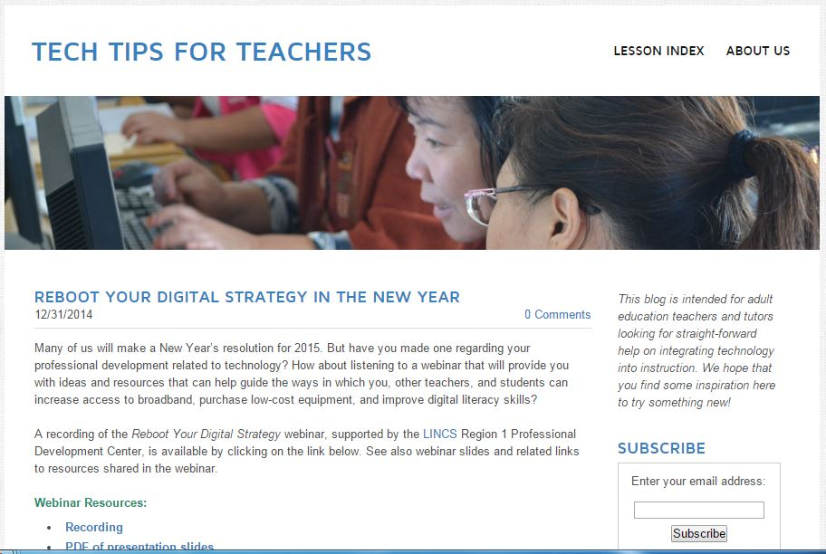
Tech Tips for Teachers
Produced by World Education, LINCS Regional Professional Development Center
TechTipsForTeachers.weebly.com/
Notes:
Say: This blog, maintained by LINCS Region 1 Professional Development Center, is a great place to watch for digital literacy updates and timely tips for integrating technology into your instruction.

Slide 38
Resources
Connected Teaching and Personalized Learning, AIR (2013)
Education for Life and Work, National Academies Press (2012)
Fueling the Race to Postsecondary Success, Council of Adult and Experiential Learning (2010)
Improving Adult Literacy Instruction: Supporting Learning and Motivation, National Academies Press (2012)
Motivation, Engagement, and Student Voice, Jobs for the Future (2012)
Opportunity for All, IMLS (2010)
Using Technology to Support At-Risk Students’ Learning, SCOPE and Alliance for Excellent Education (2014)
Who’s Online Where (WOW) Index, OCTAE (2014)
Notes:
Say: Here are all the reports we mentioned with hyperlinks so you can find them for yourself.

Slide 39
What is one thing you plan to do at your program?
Which resource:
Who:
When:
How:
Notes:
Take five minutes to fill in the blanks to the right.
Share your plan with colleagues.
Notes:
Review the question on the slide. Explain that participants will make a plan to introduce one of the resources that could address the digital literacy challenge they named at the beginning of the workshop, or another one they choose, to their program.
Invite participants to share their plans using the chat or voice webinar features.

Slide 40

Final thoughts and questions?
Notes:
Invite participants to share thoughts and questions.

Slide 41
Contact
[Facilitator name and email address]
Notes:
Thank participants for their engagement, and remind them how to find the workshop resources. Invite participants to contact you with questions.

Slide 42
Thank you!
Please complete the LINCS evaluation survey.
This session was supported under the LINCS Regional Professional Development Center for Adult Education, PR/Award Number V191B1100002, administered by the Office of Career, Technical, and Adult Education, U. S. Department of Education. However, the contents do not necessarily represent the positions of policies of the Office of Career, Technical, and Adult Education or the U.S. Department of Education, and you should not assume endorsement by the Federal Government.
Notes:
If there will be an evaluation, give instructions.

